Slide 1
Event Driven Architecture in Bahmni

Slide 2
It combines and enhances existing open source products into a single solution.
OpenMRS for electronic medical records and patient management
OpenERP for inventory, billing, accounting
dcm4Chee for DICOM & PACS
OpenELIS for laboratory management
Bahmni is an easy-to-use EMR & hospital system.
http://bahmni.org

Slide 3
Bahmni
Bahmni
Connect
HTTPS
Bahmni App(s)
(JavaScript, HTML5, AngularJS, ReactJS)
Apache Web Server
HTTP
OpenMRS Server
(Java)
OpenERP Server
(Python)
OpenELIS Server
(Java)
Dcm4Chee
Atom Feed
Atom Feed
Atom Feed

Slide 4
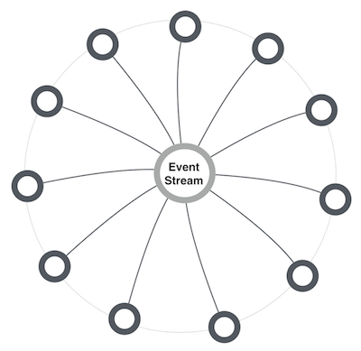
MICROSERVICES ARCHITECTURE
Choreography not orchestration
Independent systems
Integration by subscription to event streams for a category
Event Streams - Simple Atom based protocol
Asynchronous processing
All systems speaking one language (same standard)
Notes:
Independent simple systems
Integration by reacting to events originating from other systems
Allows for systems to be stay decoupled, have their independent build and release cycles
Scalability by division
Divide by catchment wise processing
Explain catchment concept
No heavy middleware (MoM)
Microservices
Multinode

Slide 5
Choreography over orchestration
Independent Systems/Domains
Integration by subscription to feeds - pull based
Event Notification/Outbound Events

Slide 6
Feed based communication & integration
Atom Feeds with entries
The series of entries is paginated over many Atom documents
Paginated Feeds (next-archive, prev-archive)
Recent Feed, Archived Feeds
Categorized feeds
/openmrs/feeds/patients/recent
/openelis/feeds/accessions/recent
Feeds are owned by individual systems - no central bus/infra
Feed consumers are expected to remember their last-processed-entry
Resume processing from last ‘marker’

Slide 7
Example: Feed
<?xml version="1.0"> <feed xmlns="http://www.w3.org/2005/Atom"> <id>urn:uuid:ff31a040-75bc-11e2-bcfd-0800200c9a66</id> <title type="text">Recent notifications</title> <link rel="self" href="https://demo.mybahmni.org/openmrs/ws/atomfeed/patient/recent" /> <link rel="prev-archive" href="https://demo.mybahmni.org/openmrs/ws/atomfeed/patient/21" /> <!-- There is no "next-archive" link as this is the most recent document. --> <link rel="via" href="https://demo.mybahmni.org/openmrs/ws/atomfeed/patient/22" /> <entry>..</entry> <entry>..</entry> <entry>..</entry> </feed>

Slide 8
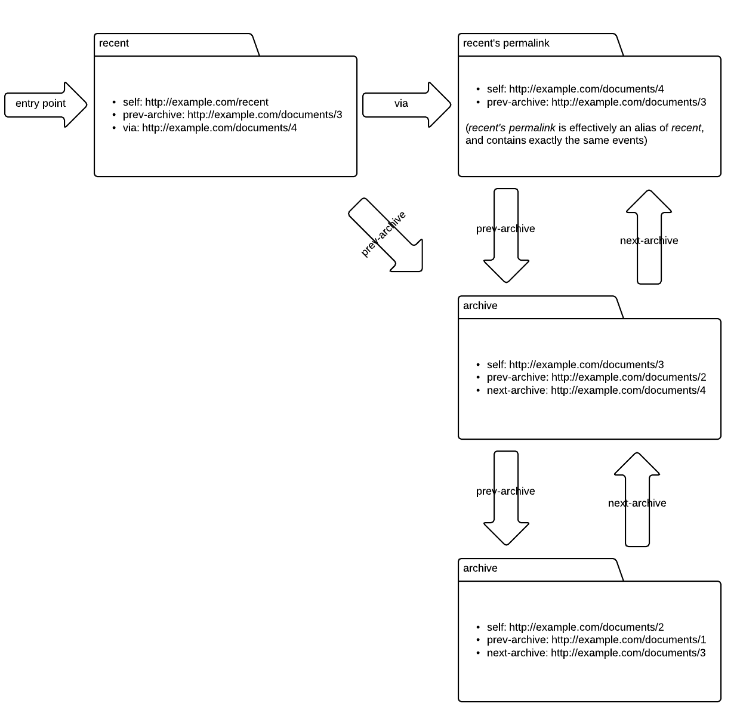

Slide 9
Example: entry
<entry>
<title>Patient Consultation Encounter</title>
<category term="OPD Consultation" />
<category term="Radiology Order" />
<id>tag:atomfeed.ict4h.org:9215cbc2-8abb-443d-a2ad-204d80fff9b0</id>
<updated>2016-10-26T09:28:07Z</updated>
<published>2016-10-26T09:28:07Z</published>
<content type="application/text">
<![CDATA[/openmrs/ws/rest/v1/patients/123/encounters/123]]>
</content>
</entry>

Slide 10
Simplefeed
https://github.com/ict4h/simplefeed (protocol documentaiton)
Libraries (https://github.com/ict4h/atomfeed)
Java implementation of feed publisher & consumer libraries
event queue-isque implementation on RDBMs

Slide 11
ARCHITECTURE
TECHNOLOGIES
Design for scalability (& at each component level) and extensibility
Standard Compliant, Interoperable & easy to integrate
Reliability, Availability, Serviceability (RAS)
Cost effective, simple
FOSS & maintainable, support
Easy to adopt/develop/deploy
Notes:
Angshu - Architecture
Neha - Technologies
May 2014 - May 2015
Technologies chosen
Influencing parameters to chose tech stack
Focus on SHR systems, not so much on Bahmni integration.
How it changed in March 2015 and we decided to deploy Bahmni on cloud.
Around June 2015, SHR goes live, we are working on stabilizing Bahmni. (No point in SHR if there no client system).
Keeping up with standards
FHIR STUs.

Slide 12
Basic Information Domain
Patient
Concepts and Terms
Location
Facility
Clinical Encounter
“Clinical Encounter” is a collection of resources (Diagnosis, Observations, Orderables, Advices etc)
Provider

Slide 13
Platform?
Core resources & apis
Extensible
You should be able to build up on top of essential services
e.g. A Patient centric “Care Plan” (say Antenatal Care) can be built over existing resources to come up with a specific profile.
e.g. A Care plan can get updated while reacting to various “clinical encounter” document generations
Feeds as means of event notification
Feeds are owned by individual systems - no central bus/infra
Feed consumers remember their last-processed-entry
Points of Care Systems (Hospitals, Community Clinics) - leverage this to keep syncing their captive area information

Slide 14
Learnings
Plugging in another system/domain is easier, building over existing system/domain
Eg: certain CHW system integrated with Bahmni for Community Worker solution using feeds
Client side
idempotency is key
Retries, resolve “some” ordering problems.
Helped us build loosely coupled systems - reference autonomy, time & platform autonomy
Hard to debug and trace event processing failures
e.g: tracing why a de-duplication action didn’t reflect in downstream systems
We built an ‘atomfeed-console’!
Interoperability
Bahmni:Different systems still speak different contracts - okay for now!
BD: HL7 FHIR resource which are more RESTful architecture aligned and federated

Slide 15
Learnings
Reuse and not reinvent the “wheel”.
Don’t come up with your “standard”! There are already are too many
Mainly, the interface contracts between components
Wish => all external interfaces in FHIR resources?
Product? - Build for ecosystem.
A main line distribution that can be easily adapted to build context specific distribution

Slide 16
THANK YOU

