Slide 1
Data Flattening using Bahmni Mart
Pramida Tumma

Slide 2
Agenda
Introduction to Openmrs and Bahmni
Problem and Solution provided
Bahmni Mart technical details
Analytical tool
Drawbacks
Impact of Bahmni Mart

Slide 3
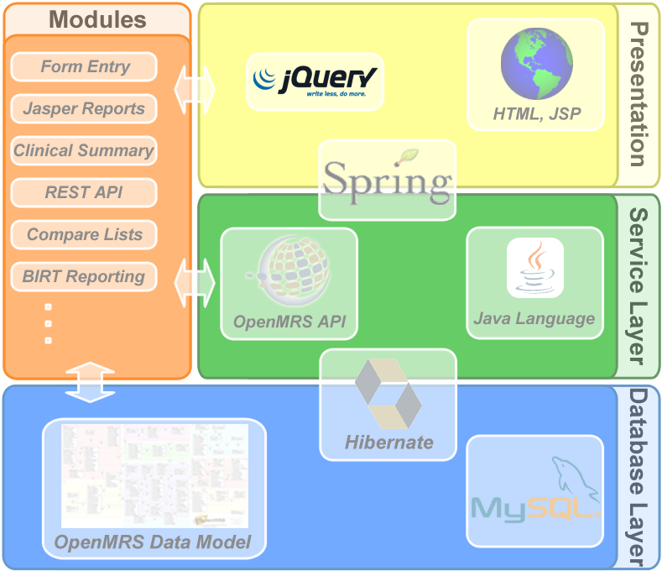
OpenMRS
World's leading open source enterprise electronic medical record (EMR) system platform.

Slide 4
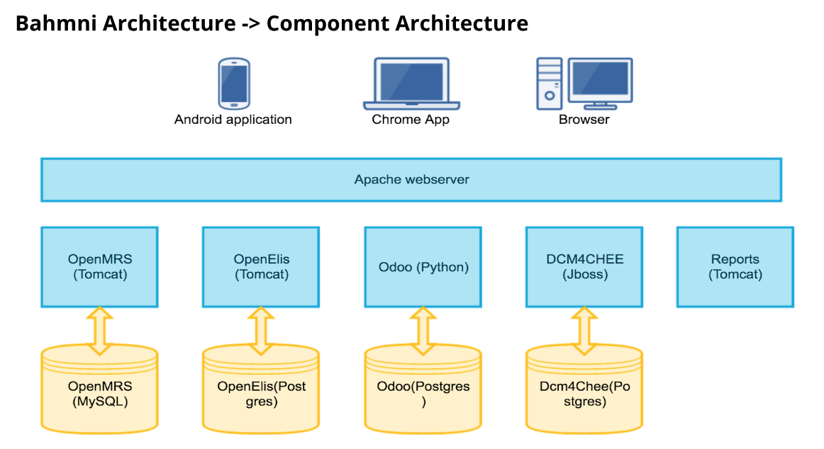
Bahmni
Open Source EMR and Hospital System for low resource settings
Distribution of OpenMRS, OpenELIS, OpenERP, DICOM and PACS
Easy to Use

Slide 5
Indicators and Reports with Data
Indicator report for every month
Time consuming
Need TW help for any new Indicator/Report
Adhoc requests like for how many patients was this drug prescribed in last 2 months
Trained people on field in SQL, OpenMRS data model

Slide 6
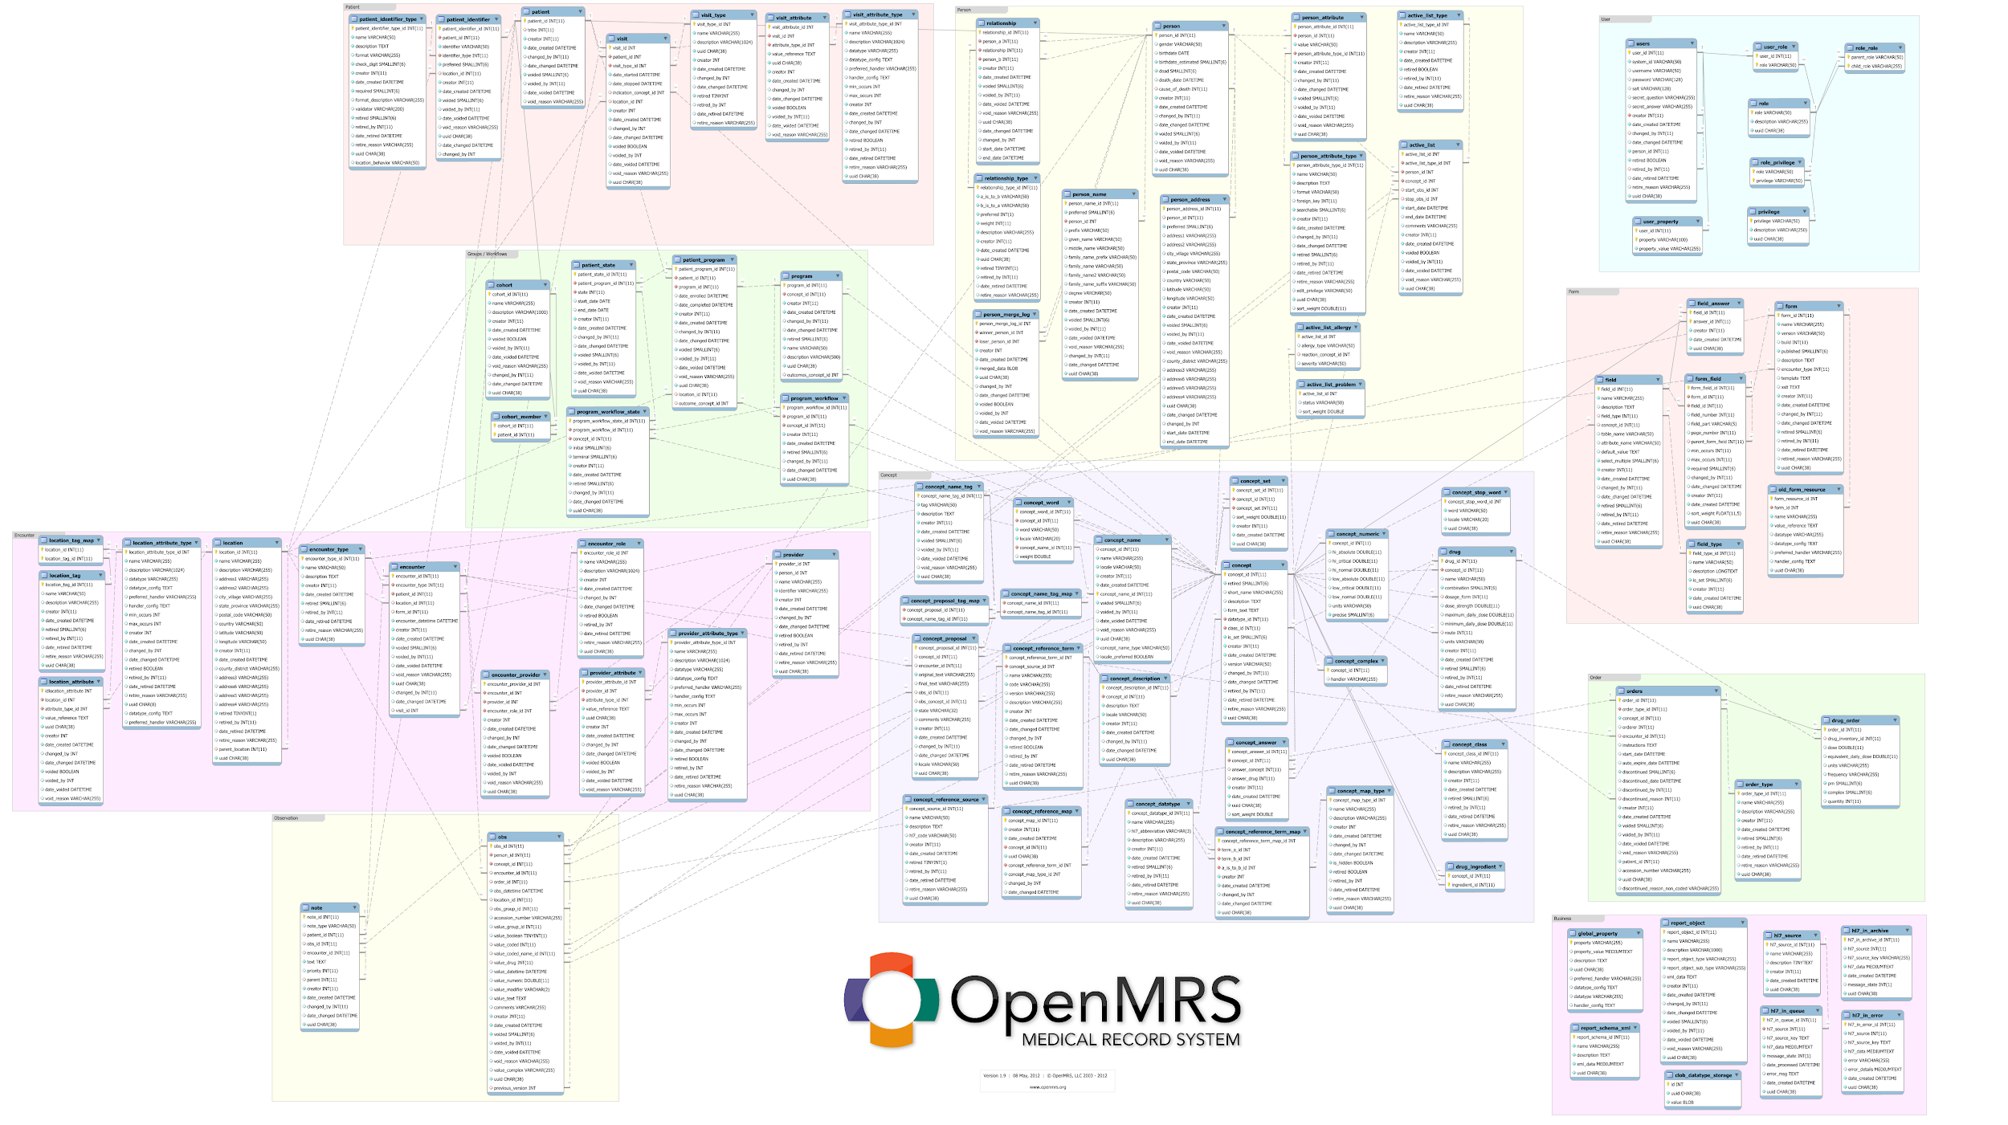

Slide 7
Bahmni Mart - Business Objective
Build a Bahmni Analytics Data Model on the complex hierarchical openMRS data model that could be packaged with Bahmni or Bahmni Lite
Will be a Generic Flat Data Model across implementations
Value:
Make it easier for various Data Analytics tools to directly consume Bahmni Analytics database

Slide 8
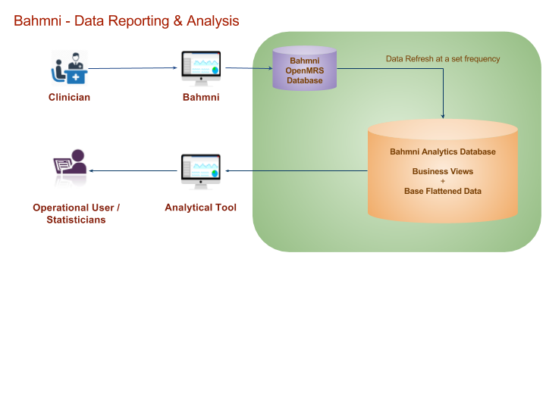
Reporting Platform

Slide 9
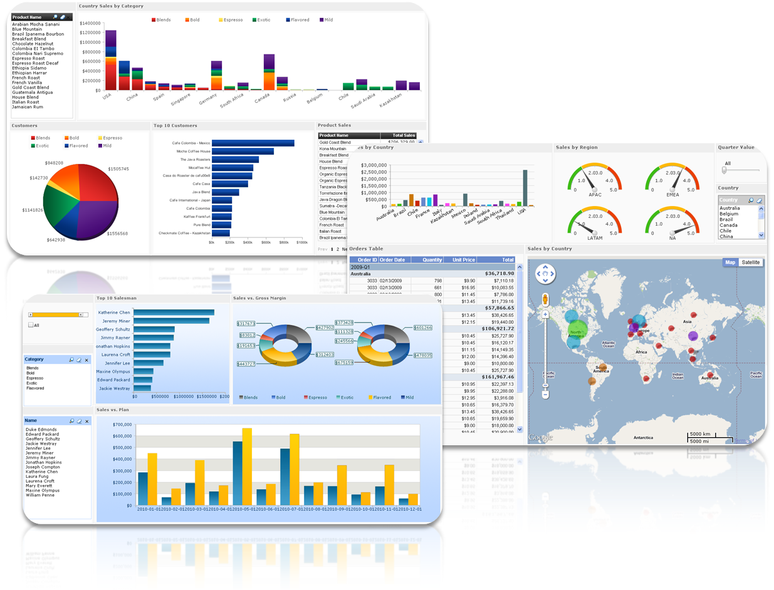
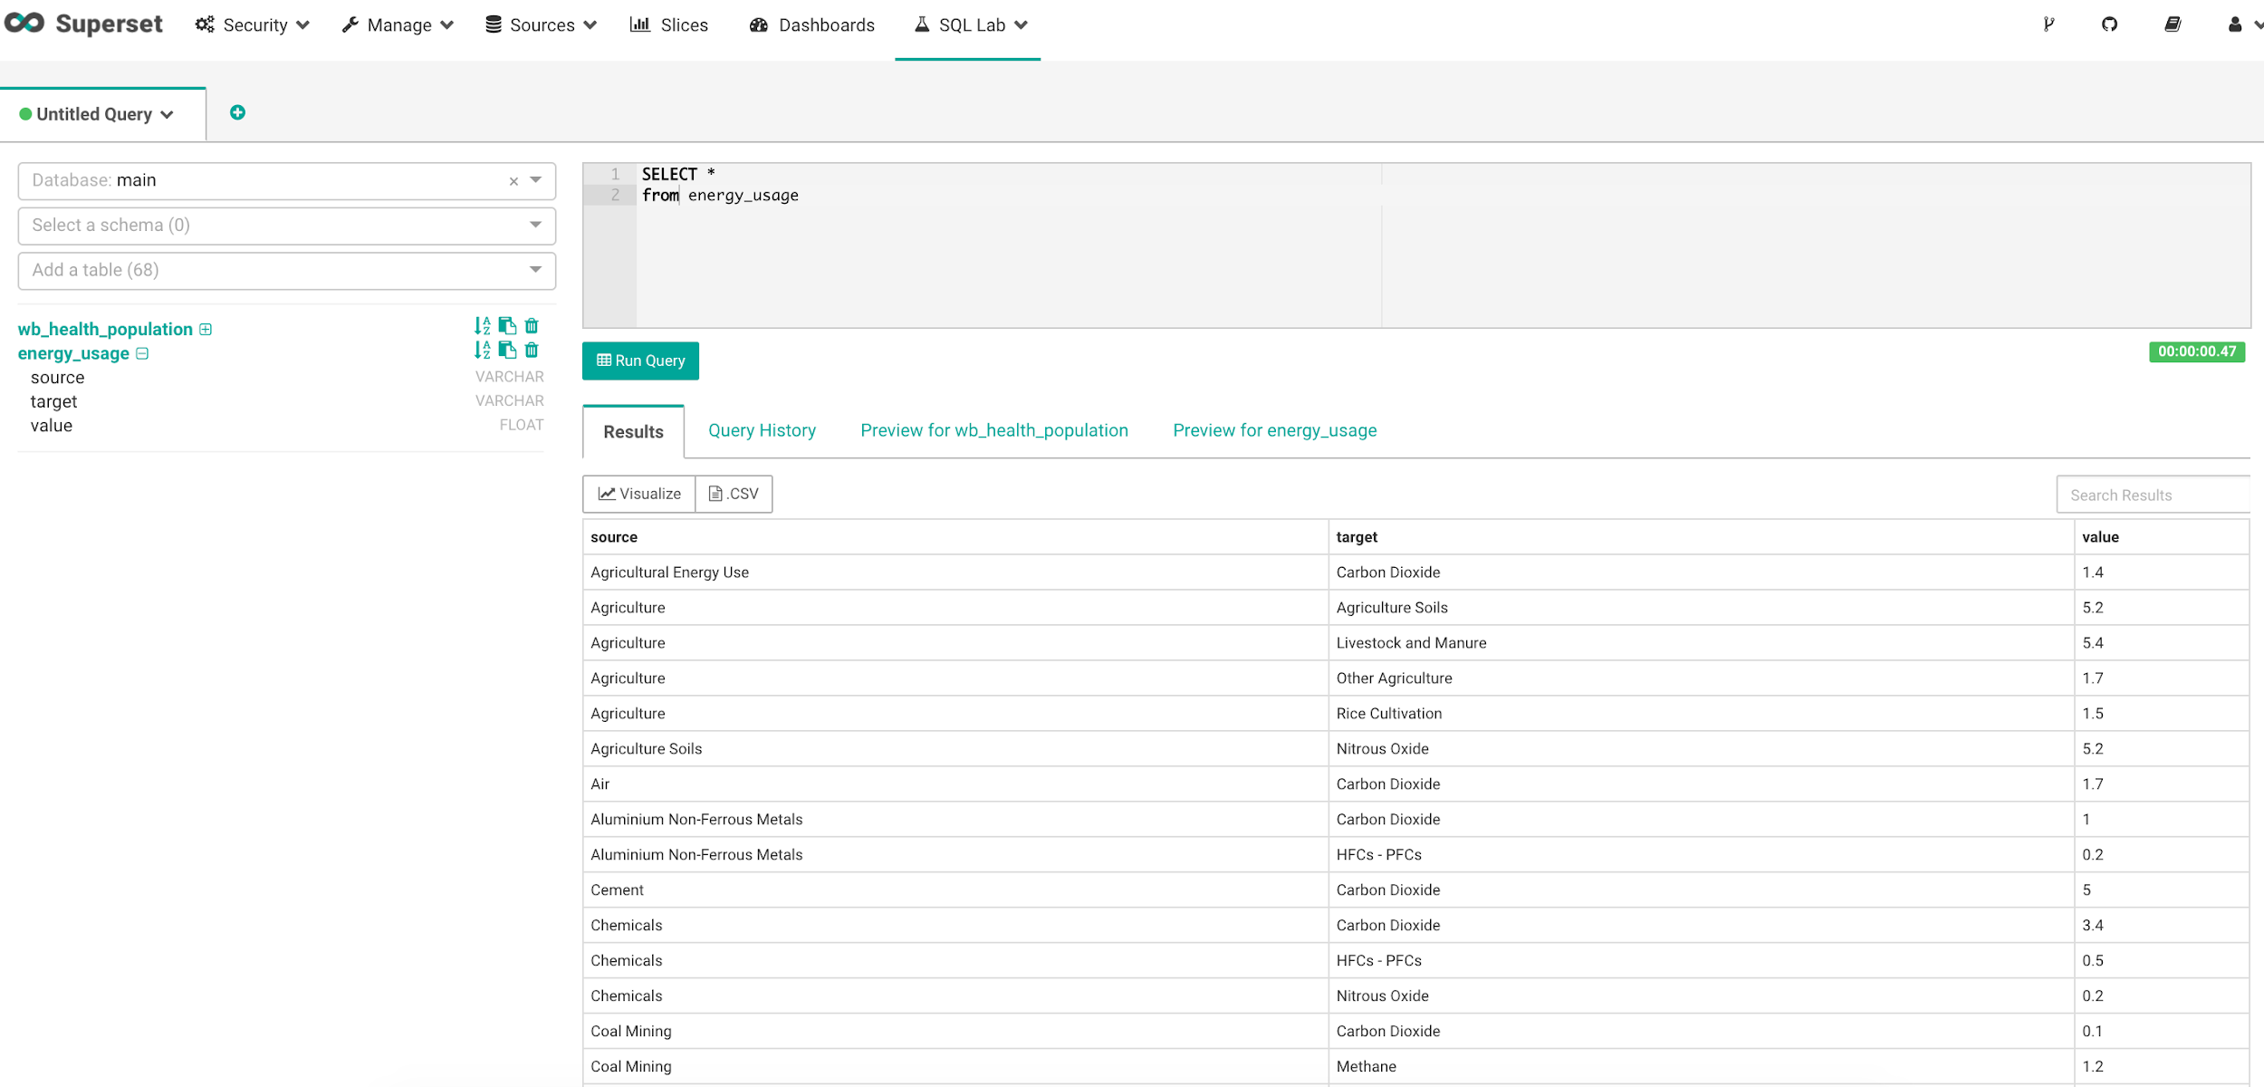
Analytics Information Architecture
Analytical Tools & Suites
Custom Defined Business Views
Alerts, Dashboards, Reports
Operational Users
Hierarchical
EMR System Data
Generic Shared Business Views
Power Users
Create Custom Defined Views & Queries
Optimized Structures
Advanced Analysis & Data Science Tools
Flat EMR System Data
Data Specialists

Slide 10
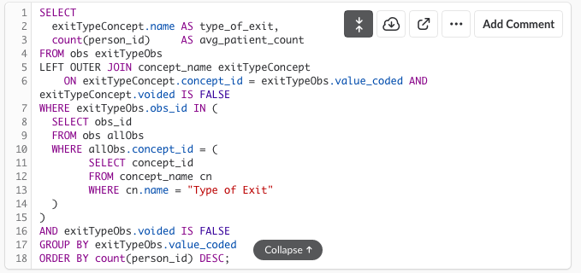
Comparison View of Query Complexity
On Hierarchical OpenMRS based Database
On Bahmni Analytics DB

Slide 11
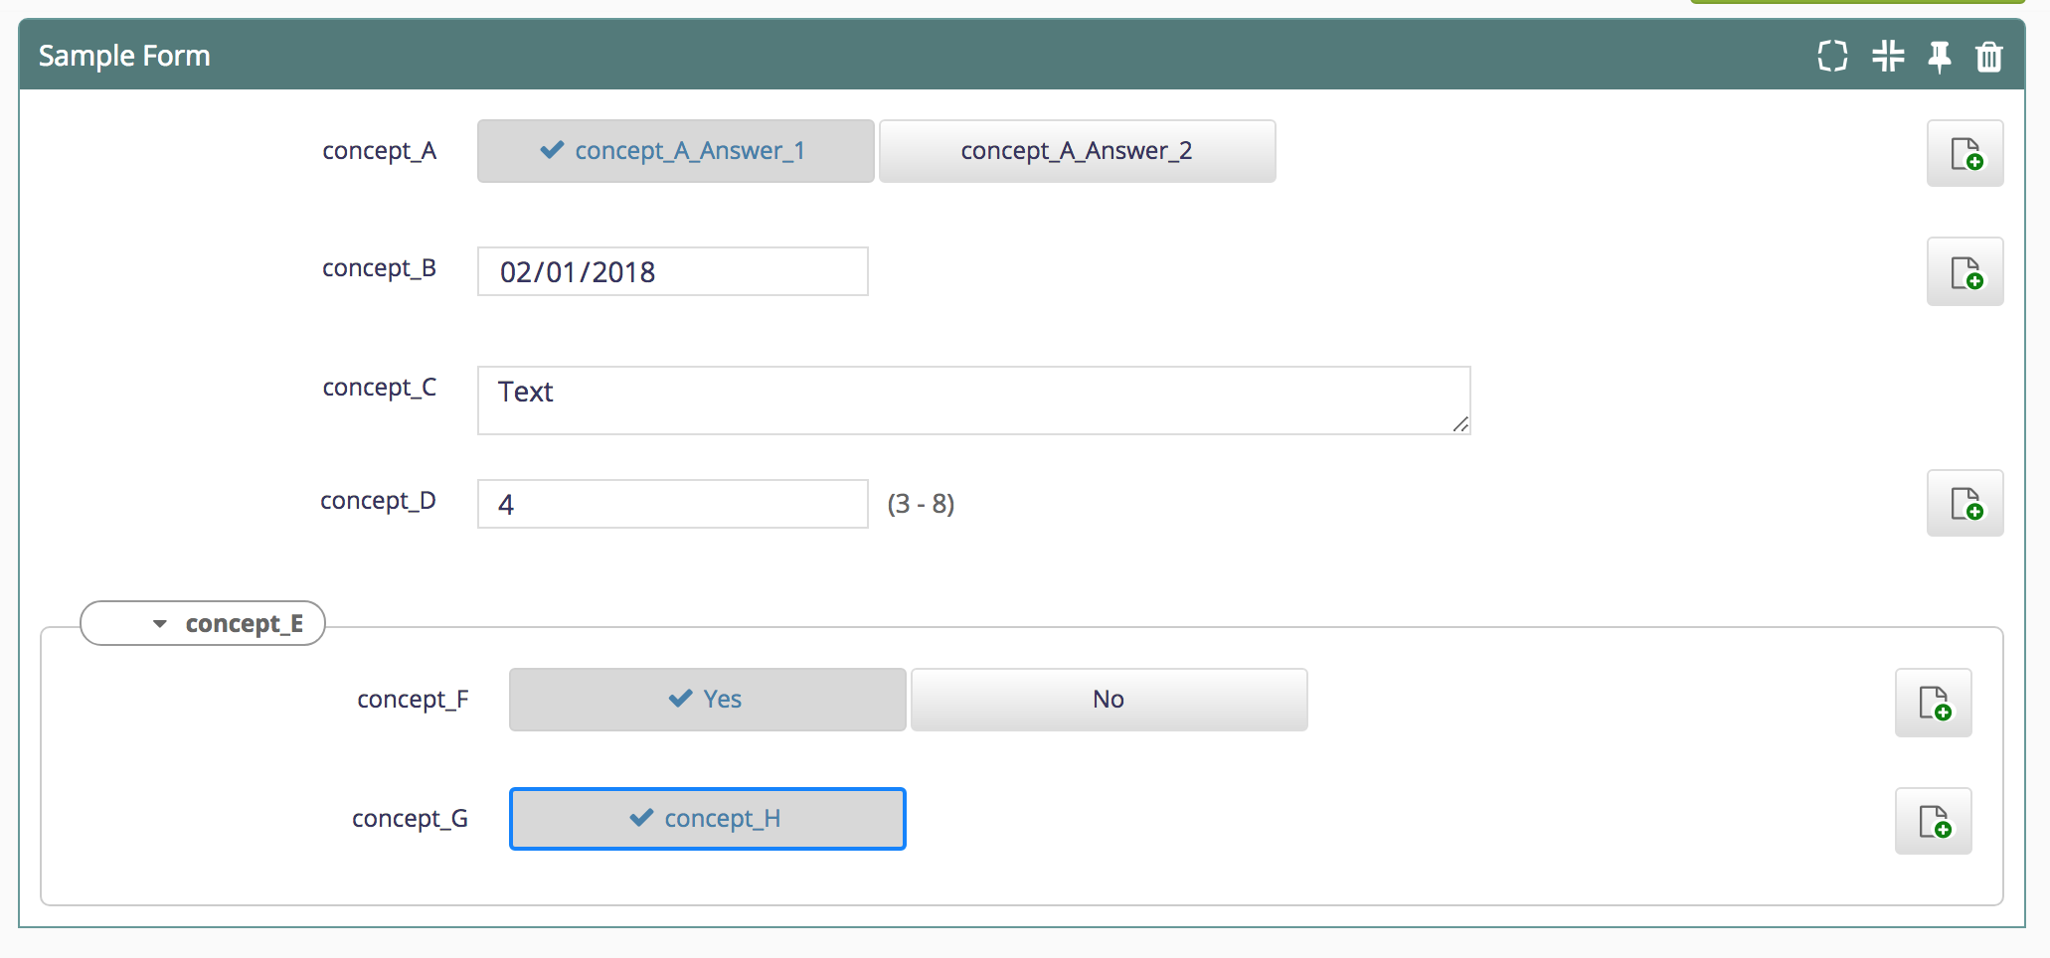
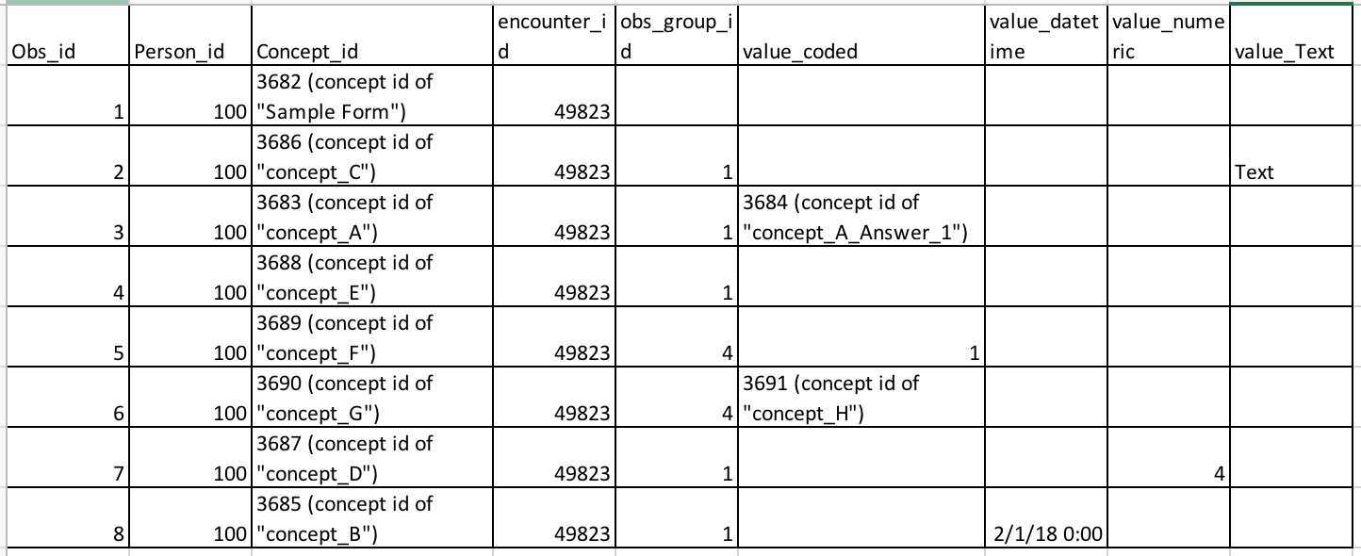
Flattening Approach
Hierarchical data - Observations
Output

Slide 12
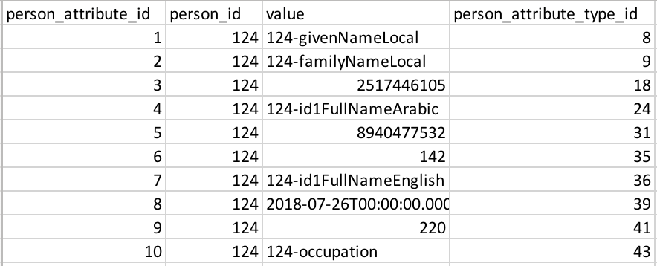
Attribute tables for user defined fields - Person attributes
Output:

Slide 13
Data across multiple tables
Patient State - Patient, patient_program, program, patient_state, users, person_name, program_workflow_state, concept_view

Slide 14
Technical Solution
Use Spring batch application to flatten the openmrs database
Input database is Openmrs database (MySql)
Output database is Mart database (Postgres)
Hierarchical
EMR System Data
MySQL
Flattened Analytical Data
Postgres
Bahmni Mart
Spring Batch Application
Job to flatten Patient data
Job to flatten Appointment data
.
.
.

Slide 15
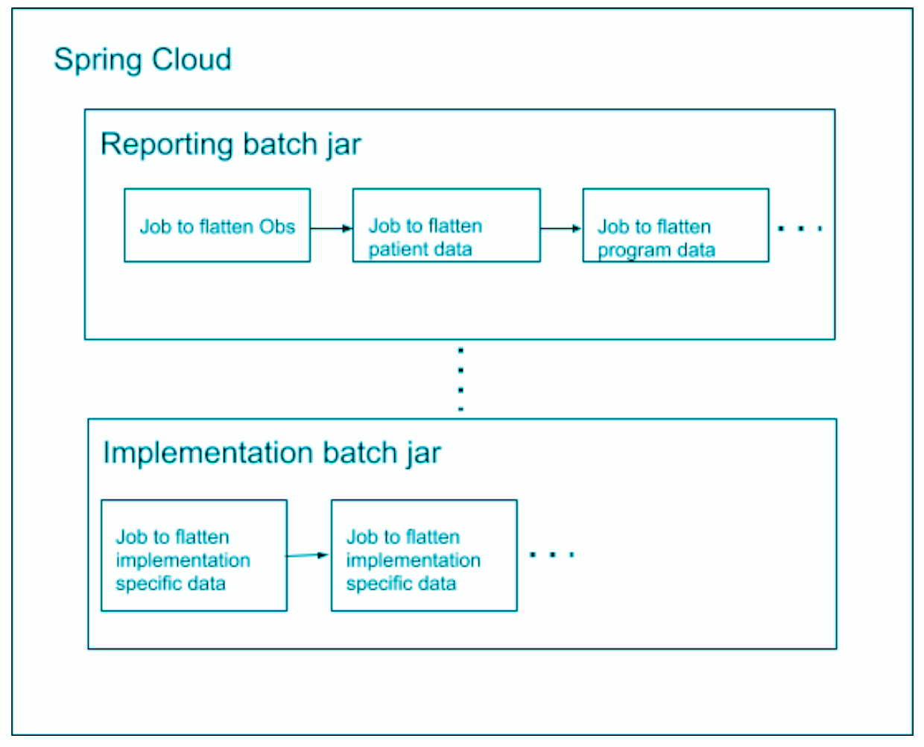
Technical Solution - Extendable

Slide 16
Incremental Updates
~2 GB - Half hour to flatten
Using Event tables and Marker tables
The tables used should be specified in the configuration
With Incremental updates it takes up to 10 mins for a month long of data

Slide 17
Other Highlights
Can be used by any Openmrs implementation
Config driven jobs
Can create a job using customSqls
Exclusion of PII data
Ignore columns that are not required
Can have coded output using concept reference source maps
Can create required views using config
Ignore free text concepts as they are not used in analysis

Slide 18
Analytical Tool
Able to connect Mart database to any analytical tool like Tableu, PowerBI
Open Source tool given by default is Metabase
Took less than a week to build all the indicators in Metabase

Slide 19
Drawbacks
Very Data specific
Scalable?
Small Data (Not BIG Data)

Slide 20
Impact of Bahmni Mart
Able to build a tool on Bahmni Mart -> Bahmni - DHIS Integration
Cost of generating reports and indicators in Bahmni got reduced to more than half
People in the field are able to generate their own reports
MSF is planning to purchase analytical tools like PowerBI, Tableu to explore more

Slide 21
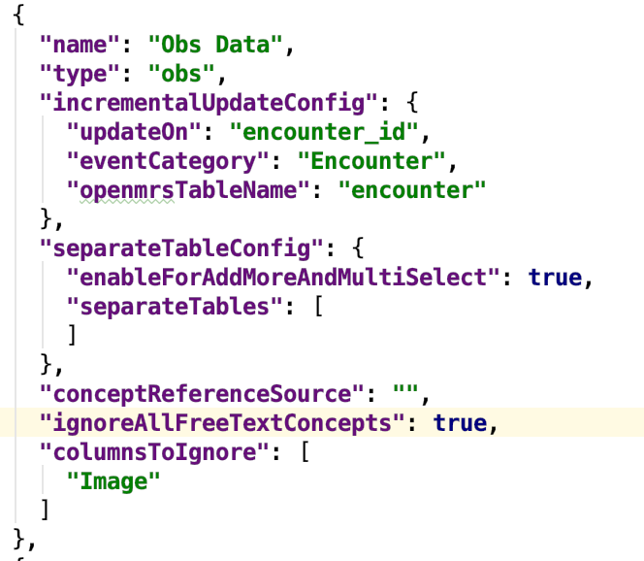
Sample Config

Slide 22
Thank You

